Slide 1
FLOCS

Slide 2
What is your best practice?
Integrated work planning
Integrated process for planning safety, quality, and productivity into work
Useful document for crews to review in the field – one stop shop
Solicit craft and crew input for creation and updates for most effective tool

Slide 3
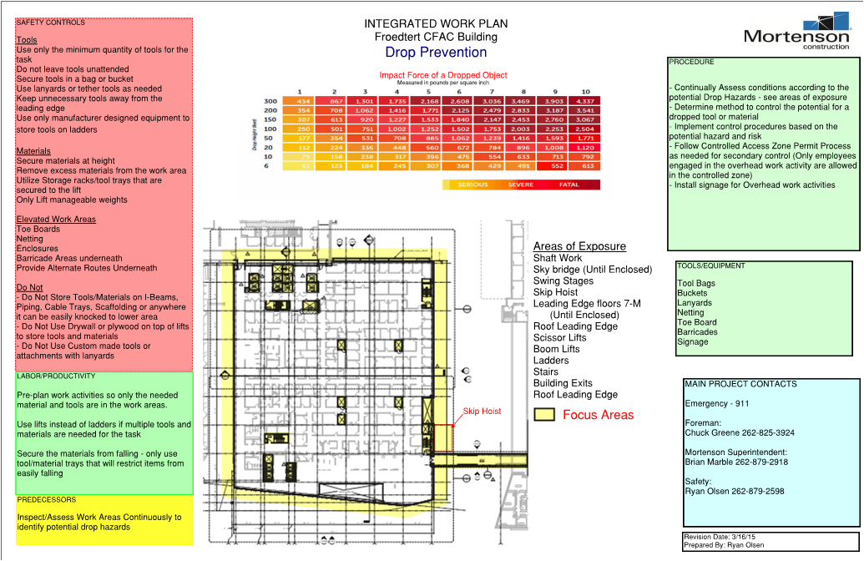

Slide 4
What does it apply to?
All definable features of work
Phase plan
Activity plan
Task plan

Slide 5
What is the cost impact?
Cost investment for planning up front
Cost savings based on better:
Safety – Committed to Zero Injuries
Quality – Committed to Zero Rework
Productivity – Committed to delivering an exceptional customer experience

Slide 6
What did it take to make it happen?
Collaborative effort between “business services groups”
Documented examples / case studies
Leadership committment

Slide 7
What did it affect?
Safety of our workforce
Innovation from our crews
Quality of our work product
Schedule

